Slide 1
Governor’s Office of Homeland and Emergency Preparedness (GOHSEP)
Recovery Funding Overview
Casey Tingle, Assistant Deputy Director
February 2015

Slide 2
Welcome
Contact Info:
Casey Tingle
Assistant Deputy Director, Hazard Mitigation
casey.tingle@la.gov

Slide 3
Recovery Framework
Recovery is complicated and collaborative
Federal government is trying to establish a more structured and multi-layered
Various Recovery Support Functions assigned to different agencies
Link: https://www.fema.gov/national-disaster-recovery-framework

Slide 4
Mission
To lead + support Louisiana and its citizens in the preparation for, response to + recovery from all emergencies + disasters.
Notes:
Our mission is to lead and support Louisiana and its citizens in the preparation for, response to and recovery from ALL emergencies and disasters.

Slide 5
Emergency Management Cycle
Preparedness
Emergency managers develop plans of action to manage & counter their risks & take action to build the necessary capabilities needed to implement such plans
MITIGATION
Prevention
Prevention happens when property and lives are protected by those that identify, deter or stop an incident from occurring
PREPARATION
Response
Response includes the mobilization of necessary emergency services & first responders in the disaster area
PREVENTION
Event
Recovery
Recovery efforts are primarily concerned with actions that involve rebuilding destroyed property, re-employment & the repair of other essential infrastructure
RESPONSE
RECOVERY
Mitigation
Mitigation efforts are attempts to prevent hazards from developing into disasters or to reduce the effects of disasters

Slide 6
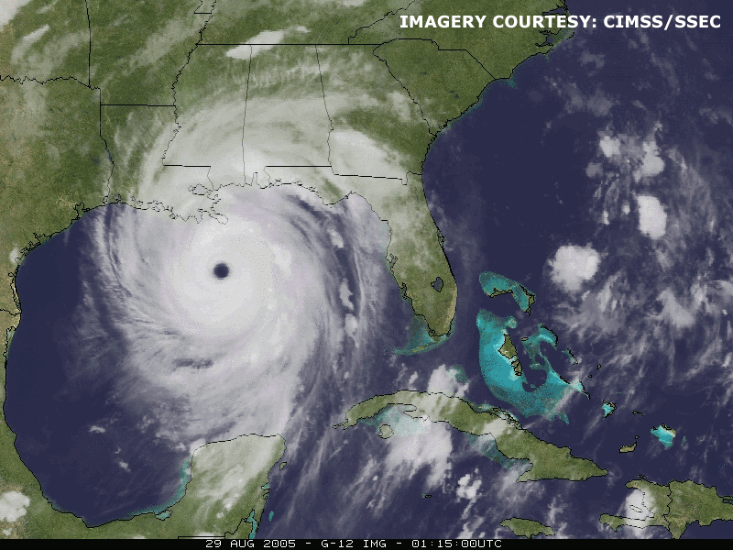
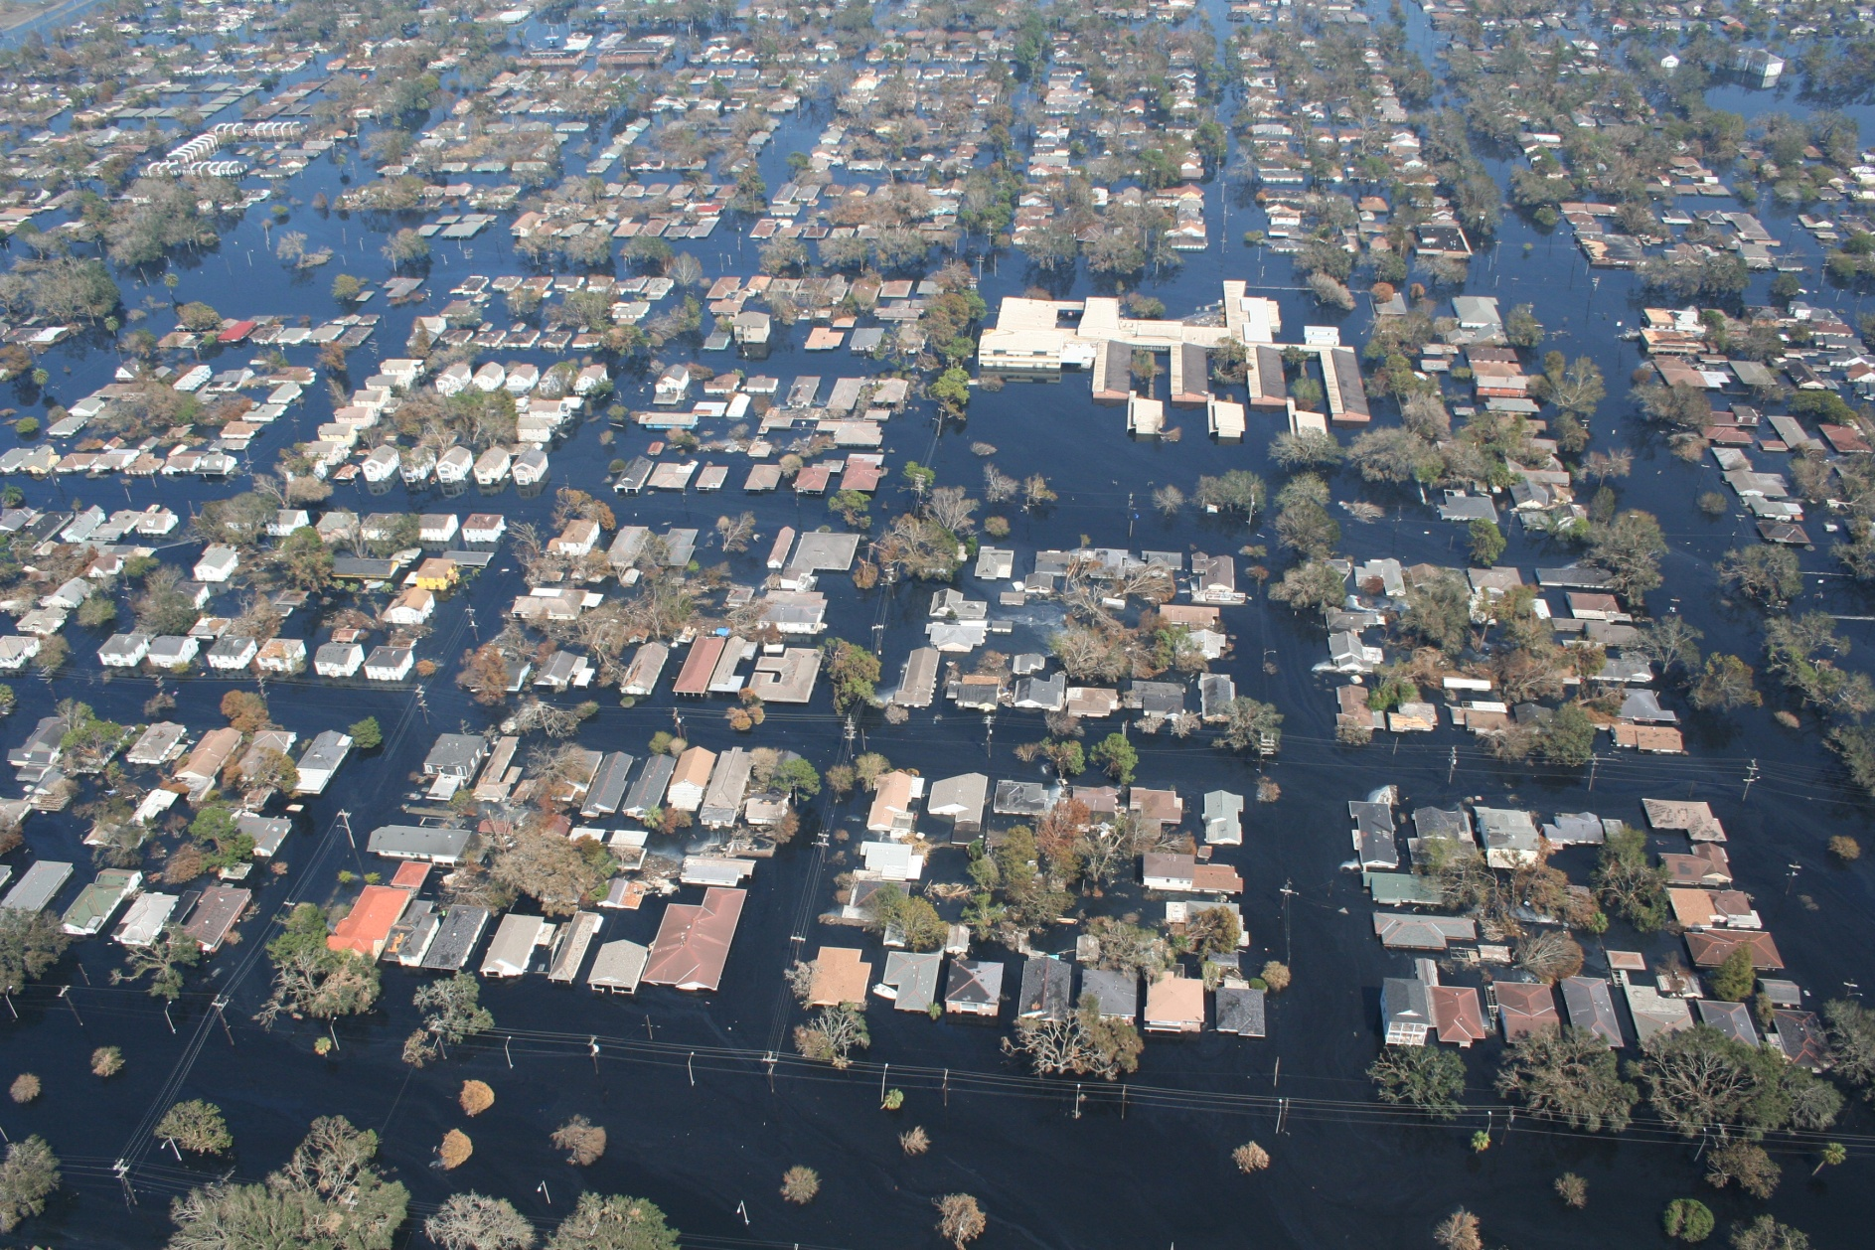
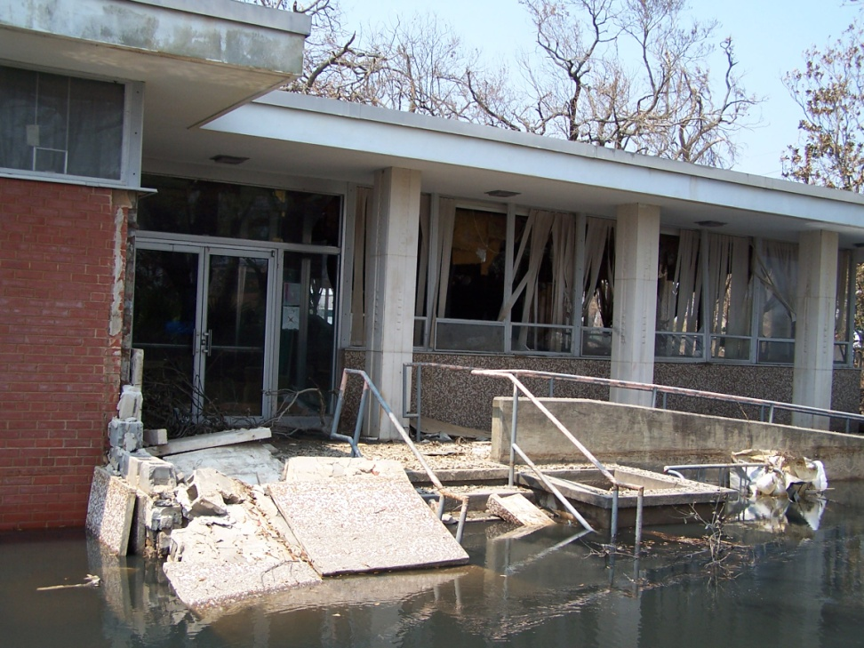
Risk
Louisiana is a high-risk State for emergency events + disasters.
Notes:
Louisiana is a high-risk State for emergency events and disasters. . . Whether from the threat of:
-Accidental hazardous materials release;
-Cyber attack, or threat of explosion;
-Weather related threats like drought, floods, fires, hurricanes, heat, thunderstorms or tornadoes;
-OR man-made threats such as dam or levee failures, or acts of terrorism . . .
NO Parish in the State is without risk for some type of emergency or disaster.

Slide 7
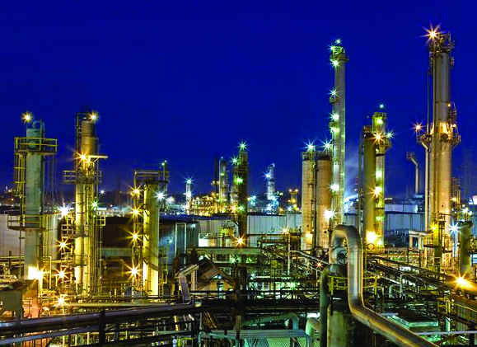
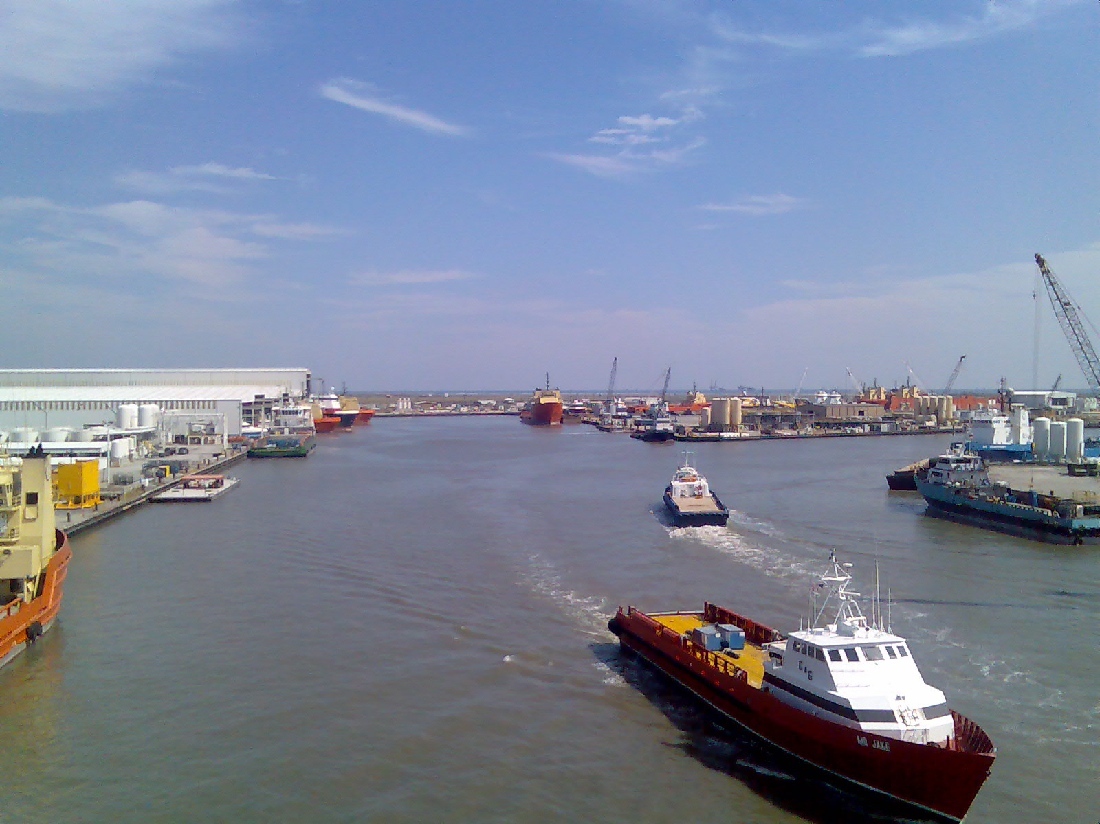
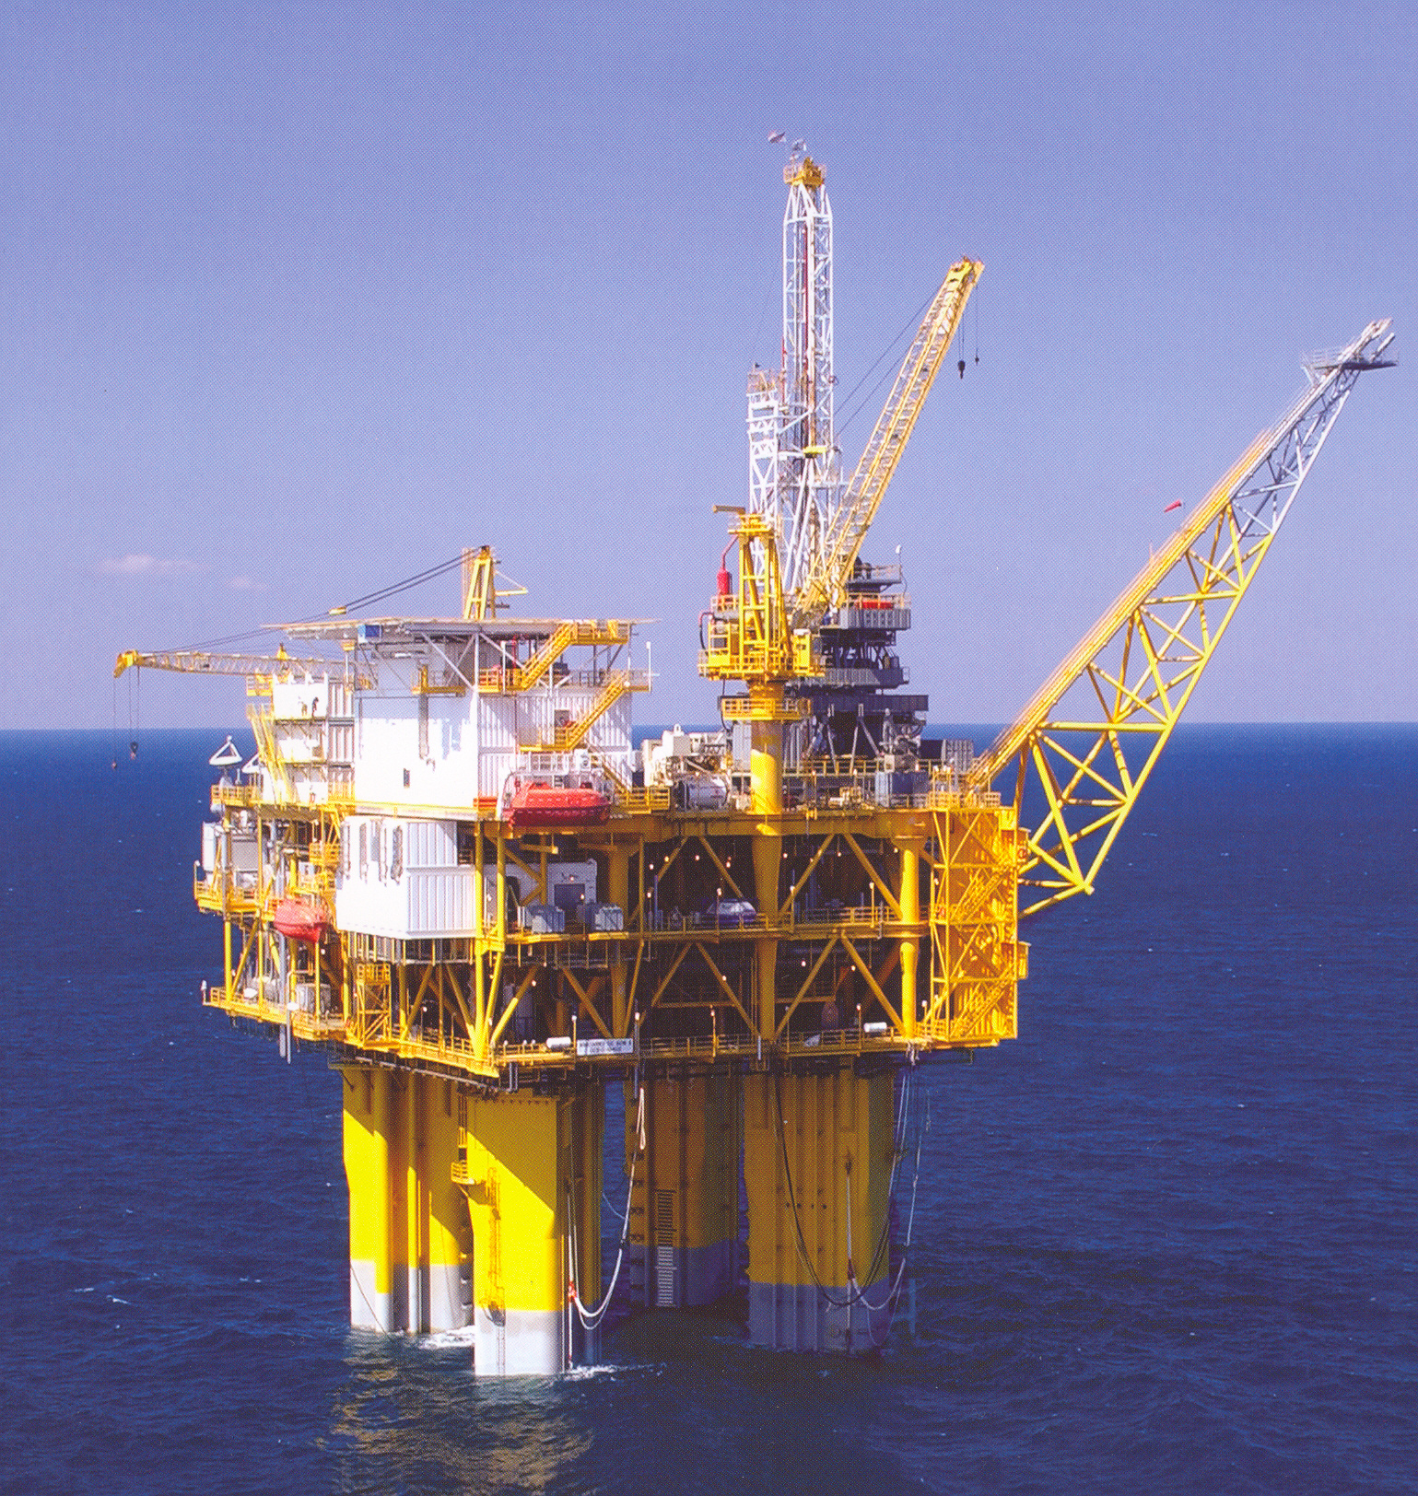
Risk (Continued . . . )
We are home to critical supply routes + energy production resources.
Notes:
Additionally, we are home to critical supply routes and energy production resources that are attractive targets for man-made disruptions.

Slide 8
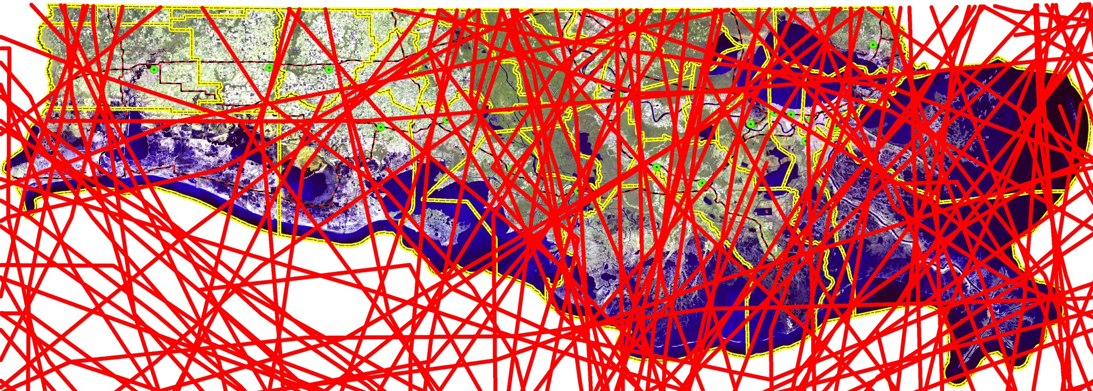
Louisiana coast - A vulnerable area for storm surge
Jeff
Davis
Acadia
St
Martin
Livingston
Saint
Tammany
Calcasieu
Iberville
Ascension
St
John
Iberia
Lafayette
St
James
Cameron
Jefferson
St Bernard
Vermilion
Assumption
St Charles
St Mary
Lafourche
Terrebonne
Plaquemines
All Atlantic Basin Tropical Systems
National Hurricane Center 1850 - 2007
Notes:
. . . showing hurricanes and other tropical-force wind events, that have struck the Louisiana coastline over the last 150 years. This does NOT include tornadoes, flooding from heavy rains in the Midwest which makes its way down the Mississippi river to Louisiana, or man-made disasters like the BP Oil Spill.

Slide 9
What do we do?
GOHSEP is the lead agency coordinating with the Federal Emergency Management Agency (FEMA) in two critical areas:
Public Assistance Grant Program
Hazard Mitigation Grant Program

Slide 10
Public Assistance Grant Program
Supplemental grant assistance for disasters declared by the President for:
Debris Removal
Emergency Protective Measures
Repair/Replacement/Restoration of disaster-damaged, publicly owned facilities

Slide 11
Hazard mitigation defined
Hazard Mitigation (HM) is any sustained action taken to reduce or eliminate future risk to people and property from natural and man-made disasters.

Slide 12
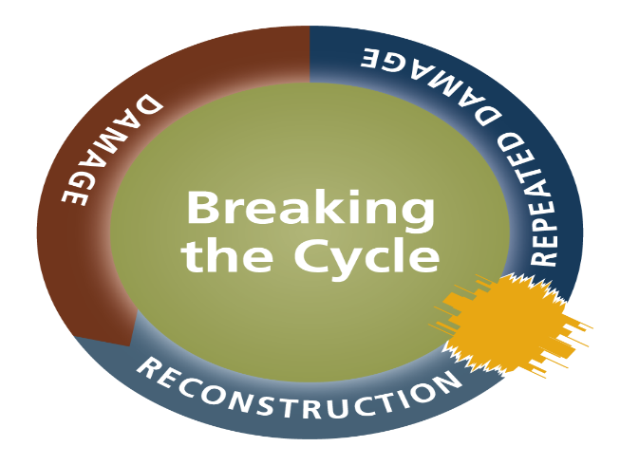
Mitigation is breaking the cycle of disaster – damage – reconstruction – repeated damage.

Slide 13
Hazard Mitigation Planning + Your Community
A Hazard Mitigation Plan (HMP) is required to receive FEMA hazard mitigation funding.

Slide 14
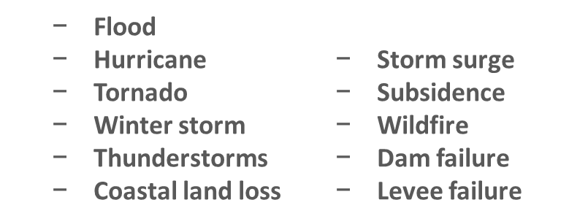
Risk Assessment: Identify Hazards
Describe all natural hazards that effect the jurisdictions in the planning area.

Slide 15
Determine vulnerability + impact
Vulnerability
Demonstrated through past occurrences.
Characteristics of the community’s assets that make jurisdictions susceptible to damage.
Impact
Consequences or effects of past occurrences on the community assets.

Slide 16
Mitigation Strategy
Blueprint for mitigation disaster losses
State goals:
Improve education + outreach efforts.
Improve data collection . . .
Possible actions:
HM workshops.
Mitigation projects.
Other . . .
Prioritize actions to guide how you implement funding.

Slide 17
Cost Effectiveness Requirement
Demonstrate cost-effectiveness.
Must be cost-effective + substantially reduce the risk of future damage, hardship, loss or suffering resulting from a major disaster.
Should be demonstrated by performing a Benefit Cost Analysis - BCA.

Slide 18
Examples of eligible activities

Slide 19
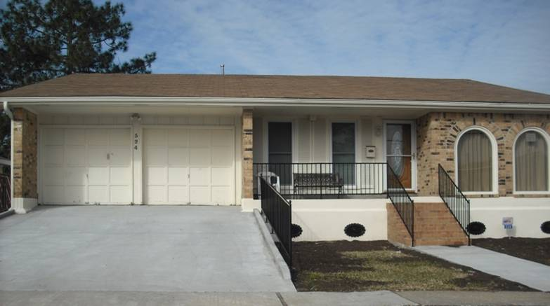
Elevated dwelling

Slide 20
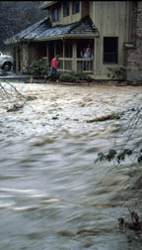
Acquisition of flood-prone property
Before
After

Slide 21
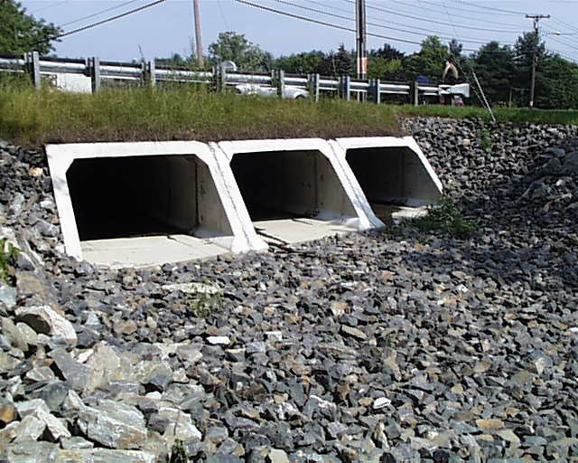
Storm water management
Culvert upgrade

Slide 22
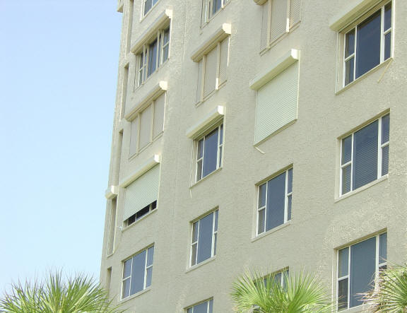
Retrofit (Shutter protection)

Slide 23
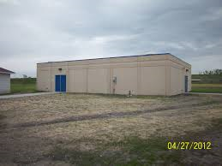
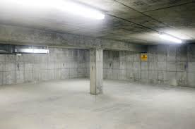
Safe room - Community

Slide 24
Louisiana open disasters
DISASTER | PUPLIC ASSISTANCE (PA) TOTAL ELIGIBLE DAMAGES | HAZARD MITIGATION (HM) LOCK-IN
Hurricane Katrina | $11,465,229,557 | $1,722,818,666
Hurricane Gustav | $773,747,138 | $225,071,189
Hurricane Rita | $666,433,725 | $137,903,000
Hurricane Isaac | $411,610,083 | $66,975,168
Hurricane Ike | $234,423,454 | $54,014,258
2011 Floods | $47,992,762 | $2,026,125
2006 Floods | $12,948,427 | $0
2009 Floods | $8,652,405 | $895,384
Tropical Storm Lee | $7,816,226 | $900,000
2013 Floods | $4,456,613 | $456,668
TOTAL | $13,663,310,390 | $2,211,060,458
So
NOTE: Three (3) are on FEMA’s Top 10 U.S. Disaster list: Katrina, Rita and Ike.
SOURCE: www.louisianaPA.com and www.louisianaHM.com, dated 1/16/15.
Notes:
As indicated, Louisiana is currently managing Stafford Act grant funding to recover from 10 Federally declared disasters reaching back to Katrina in 2005.
We are administering almost $16 billion between the FEMA Public Assistance program and the Hazard Mitigation program and we have not yet finalized the process of identifying all eligible damage, which could add as much as another
$1.5 billion to the recovery effort.

Slide 25
By the numbers
PUBLIC ASSISTANCE (PA) | HAZARD MITIGATION (HM)
1,586 obligated unique Subgrantees | 120 unique Subgrantees
35,860 projects | 848 projects
Over $13.6 billion Federal funds | Over $2.2 billion Federal funds
Average $1 billion per year or nearly $100 million per month
SOURCE: www.louisianaPA.com and www.louisianaHM.com, dated 1/16/15.
Notes:
One indication of the complexity of the recovery is the size of the recovery.
We are working with more than 1,600 unique applicants comprised of State Agencies; local governmental entities from Parishes, to Sheriffs, to School Districts and colleges and Universities; Police and Fire officials; Levee Boards, and numerous nonprofit organizations from Tulane, Loyola, Xavier, faith-based organizations that offer public services like schools, senior centers, day care, and more.
We are managing, with our Applicants, more than 36,000 individual projects.
We have disbursed an average of $1 billion a year since 2007; approximately $100 million a month, as reimbursement for expenses incurred by Applicants for eligible recovery work.
As the following chart shows, it has taken a huge effort over the past 10 years
working with FEMA to identify all eligible funding. We have averaged $1 billion per year in additional obligations and, as noted earlier, still have $1.5 billion to capture.
With communities so severely impacted, it has been difficult in many cases to start the recovery process. Communities cannot “float” the differences between what FEMA thinks a project will cost to and what an Applicant’s professional architects and engineers believe it will cost. All eligible damages must be identified up front – communities simply do not have the necessary cash flow to fund projects and then debate with FEMA after completion about what was eligible. That model only works in smaller disasters.

Slide 26
Recovery Slowdowns
Complexity – processes
Capacity - volume
Speed - risk

